Slide 1
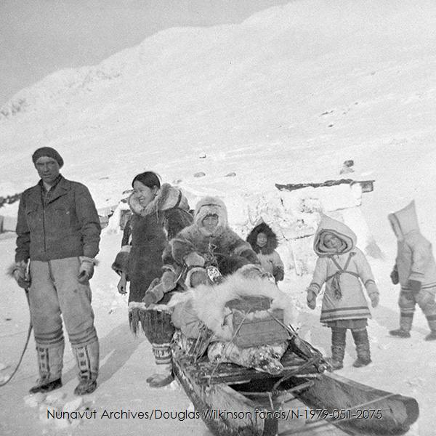
Ajjiliurlagit
Inuit Qaujimajatuqangit Through the Photographs of Joseph Idlout
This educational material has been developed by Augatnaaq Eccles, BA History.
Notes:
Exhibition overview, intro into what the exhibition is about.

Slide 2
Joseph Idlout
Joseph Idlout was the camp leader of Aulatsivik (camp outside of Mittimatalik), and was known to be a great hunter. He became one of the best-known Inuit during the 1950s after he starred in the film "Land of the Long Day" in 1952.

Slide 3
WHAT WAS HAPPENING IN iNUIT nuNANGAT DURING THIS TIME? (1950-1960)
High Arctic Relocations
Dog slaughters
Inuit moved into permanent settlements

Slide 4
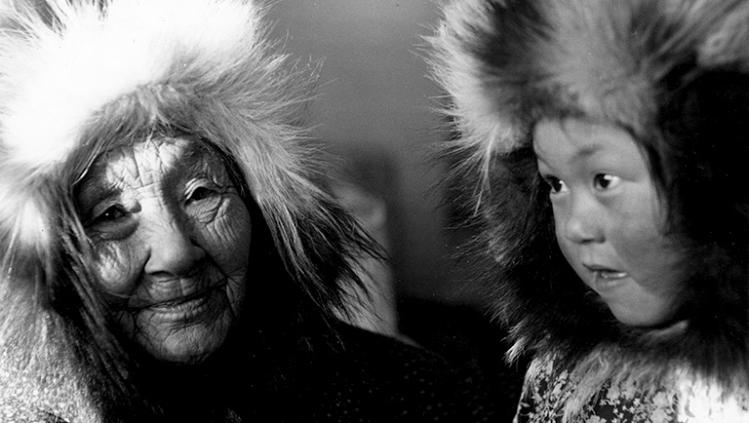
Photographs of Inuit Taken by Qallunaat
https://www.canadashistory.ca/explore/first-nations-inuit-metis/life-on-the-land
Notes:
Before we dive into the photographs taken by Idlout, I would like to show you guys some photos of Inuit taken by Qallunaat during this time, and some from before, so that we can compare them to the pictures taken by Idlout.

Slide 5
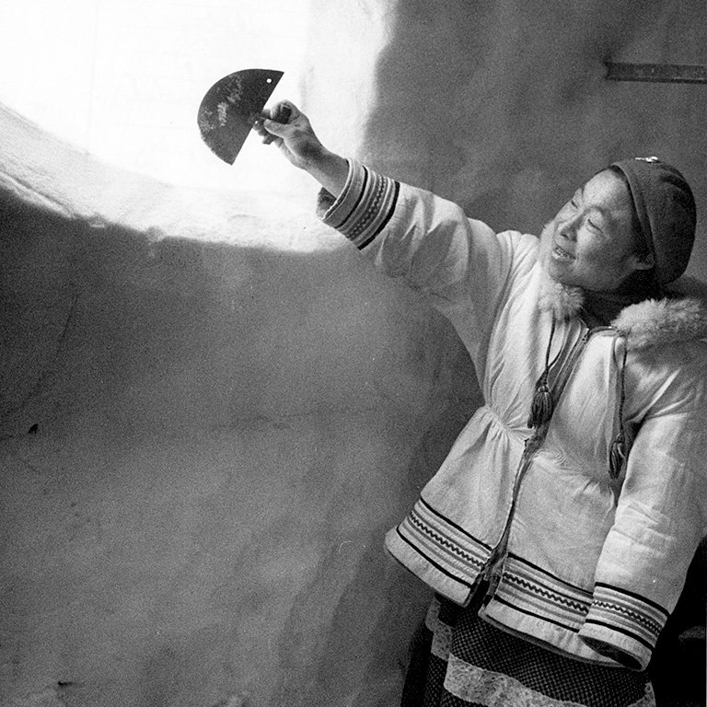
An [Inuk] woman identified as Louisa scrapes an ice window inside an igloo at Povungnetuk, in what’s now Nunavut, in a 1959 photo by Richard Harrington.
What do you see in this photo?
Does anything catch your eye?
How does it make you think about Inuit and Inuit culture?
Karine Duhamel “Life on The Land” in Canada’s History. September 2, 2021.
HBCA-1987-363-E-435-016

Slide 6
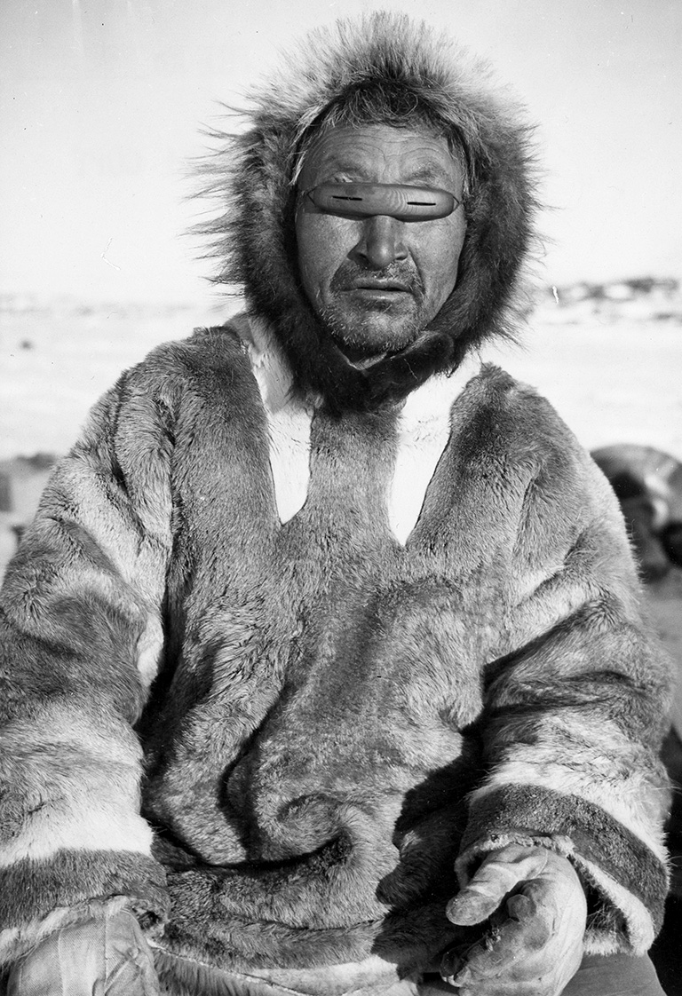
Henry Aod-la-toak wears a pair of wooden goggles that was used to prevent snow blindness. The undated photo is by Canon J.H. Webster, an Anglican missionary who ministered in Coppermine, N.W.T., from the 1930s to the 1950s. It appeared in the March 1949 issue in an article on life in the Coronation Gulf region of what’s now Nunavut.
What do you see in this photo?
What does it tell you about Inuit and Inuit culture?
Karine Duhamel “Life on The Land” in Canada’s History. September 2, 2021.
HBCA-1987-363-E-152-004A

Slide 7
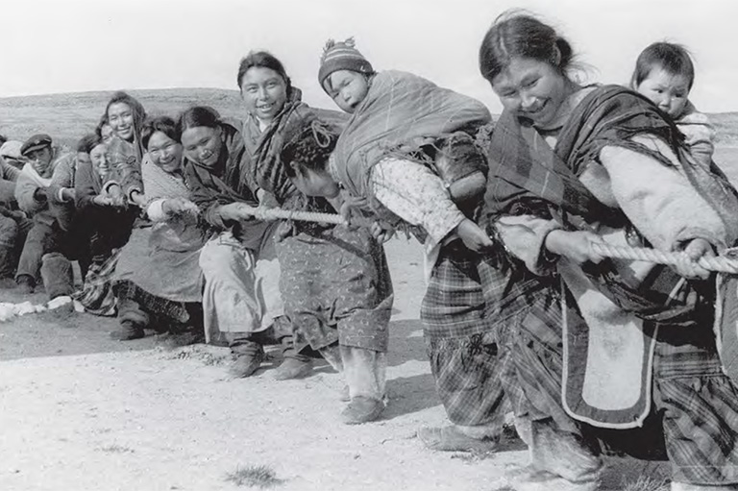
Members of an unidentified Inuit community participate in a tug-of-war competition in a 1934 photo by H. Bassett.
What do you see in this photo?
What does it tell you about Inuit and Inuit culture?
Karine Duhamel “Life on The Land” in Canada’s History. September 2, 2021.
HBCA-1987-363-E-220-042

Slide 8
Inuit Qaujimajatuqangit
What is Inuit Qajimajatuqangit?
Why is it important?

Slide 10
Inuit Qaujimajatuqangit
IQ is described in many ways but can be understood to be wisdom passed down from generation to generation.
Jaypeetee Arnakuk defined IQ as “a [way of] rationalizing thought and action, a [way to] organizing tasks and resources, a [way of] organizing family and society [into wholes].”
Elder Mariano Aupilaarjuk described IQ, saying, “[IQ] is based on the truths of Inuit culture and the desire to live in harmony. Living in harmony like that we can expect a better world to surround us.”

Slide 11
Why organize an exhibition through Inuit Qaujimajatuqangit?

Slide 12
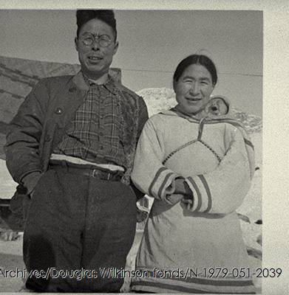
Idlout's Photographs
The photographs captured by Idlout and presented in this section have been selected from the Douglas Wilkinson fonds housed in the Nunavut Archives.

Slide 13
Ikajuqatigiingniq
Working together for a common cause.

Slide 14
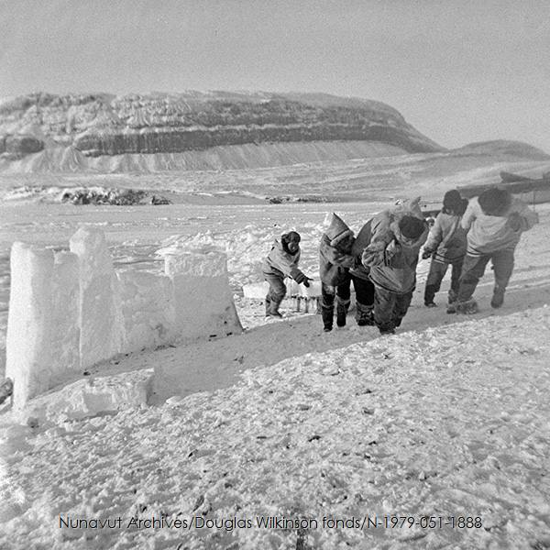

Slide 15
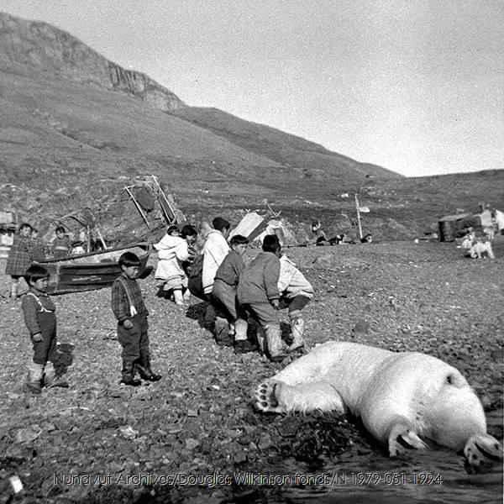

Slide 16
Pilimmaksarniq
Development of skills through observation, mentoring, practice, and effort.

Slide 17
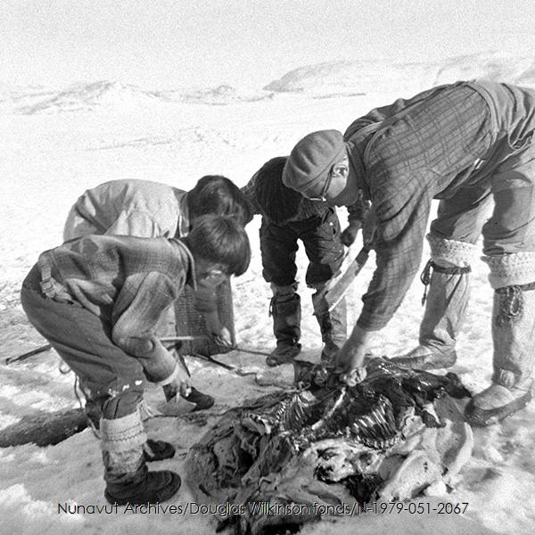

Slide 18
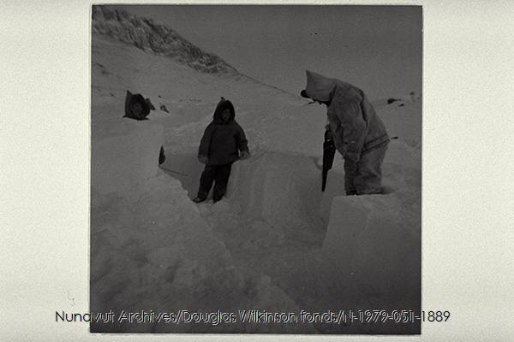

Slide 19
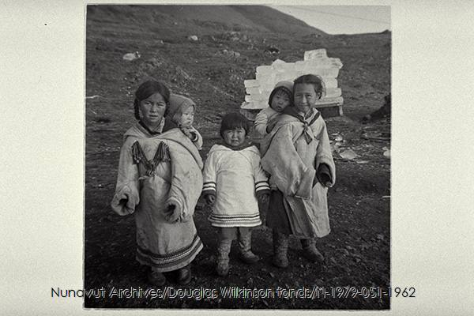

Slide 20
Qanuqtuurniq
Being innovative and resourceful.

Slide 21
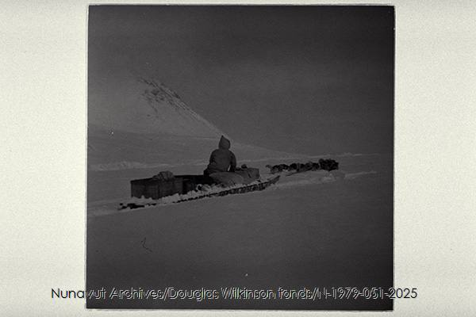

Slide 22
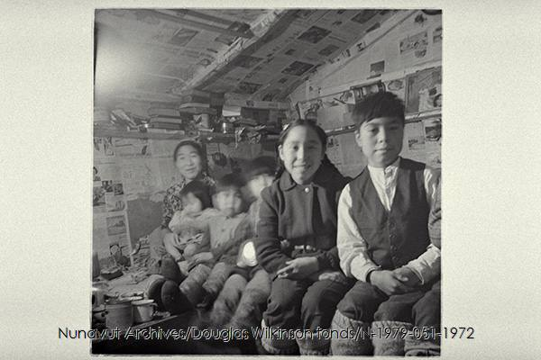

Slide 23
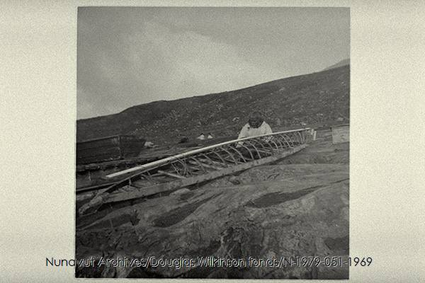

Slide 24
Inuuqatigiitsiarniq
Respecting others, relationships and caring for people

Slide 26
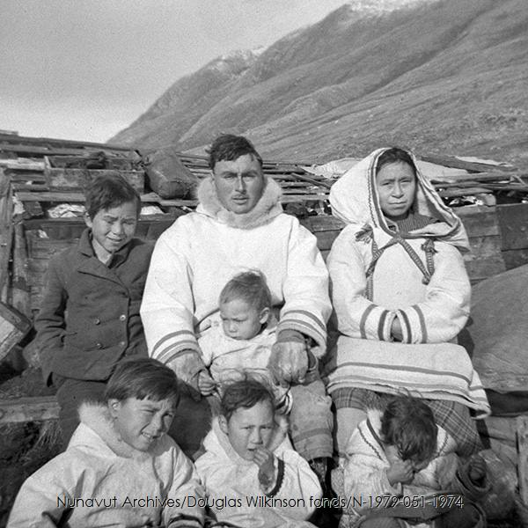

Slide 27
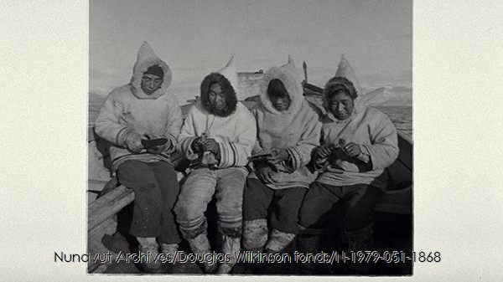

Slide 28
Final Discussion Questions:
What was your favourite picture from the exhibition? What did you like about it?
Any other thoughts about the presentation.

Slide 29
Creative response:
Choose one Inuit Qaujimajatuqangit principle that stands out to you and take a picture that shows the principle in action.

Slide 30
Citations
Karine Duhamel “Life on The Land” in Canada’s History. September 2, 2021. Accessed online at https://www.canadashistory.ca/explore/first-nations-inuit-metis/life-on-the-land
Heather Campbell, "Tunniit/Tattoos The Complicated History of Photographing Inuit Tattoos" in Library and Archives Canada Blog. January 14, 2021. Accessed online at https://thediscoverblog.com/2021/01/14/tunniit-tattoos-the-complicated-history-of-photographing-inuit-tattoos/
Idlout's photographs are housed in the Douglas Wilkinson fonds (in the Nunavut Archives).

